Slide 1
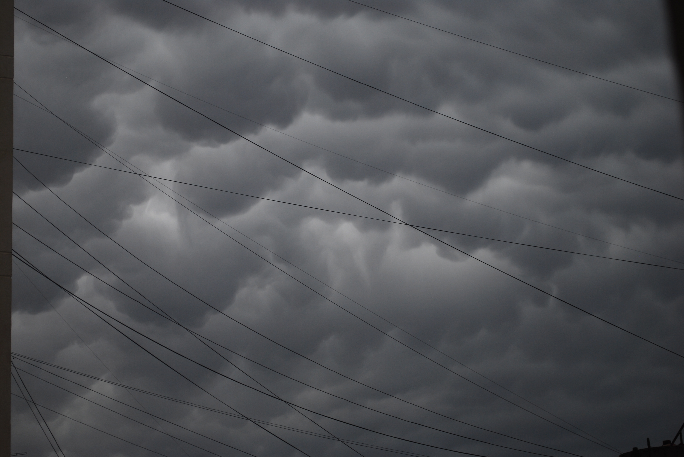
The PLENK, The PLE and We
Stephen Downes
December 1, 2010

Slide 2
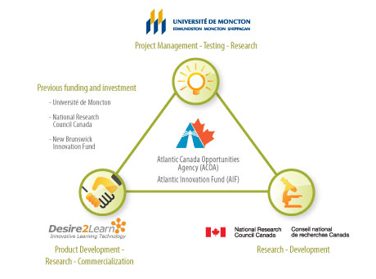
Synergic3
http://www.synergic3.com/

Slide 3
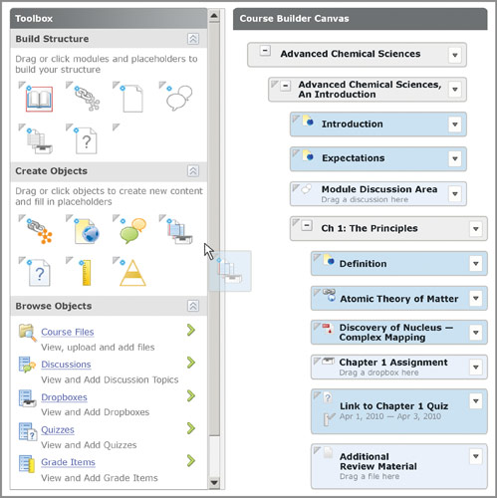
Instructional Design
http://www.desire2learn.com/news/newsdetails_161.asp

Slide 4
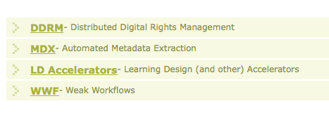
Research Agenda

Slide 5
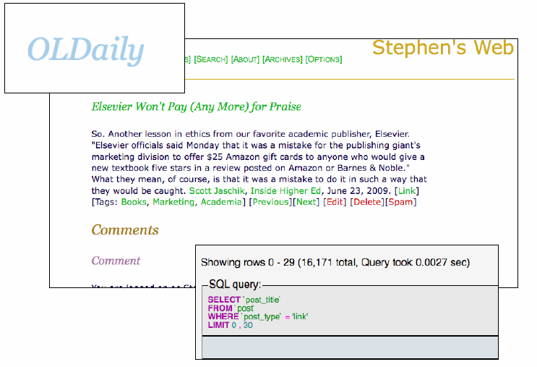
OLDaily
http://www.downes.ca/news/OLDaily.htm

Slide 6
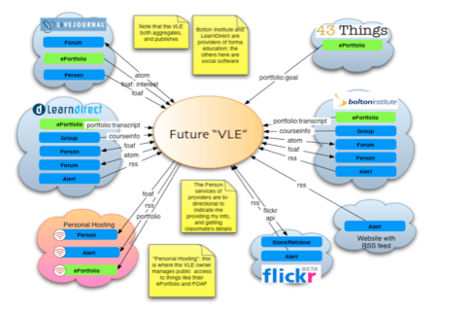
The Personal Learning Environment
Using networks to learn…
Image: http://www.cetis.ac.uk/members/ple/resources/edf.ppt
http://ple.elg.ca/

Slide 7
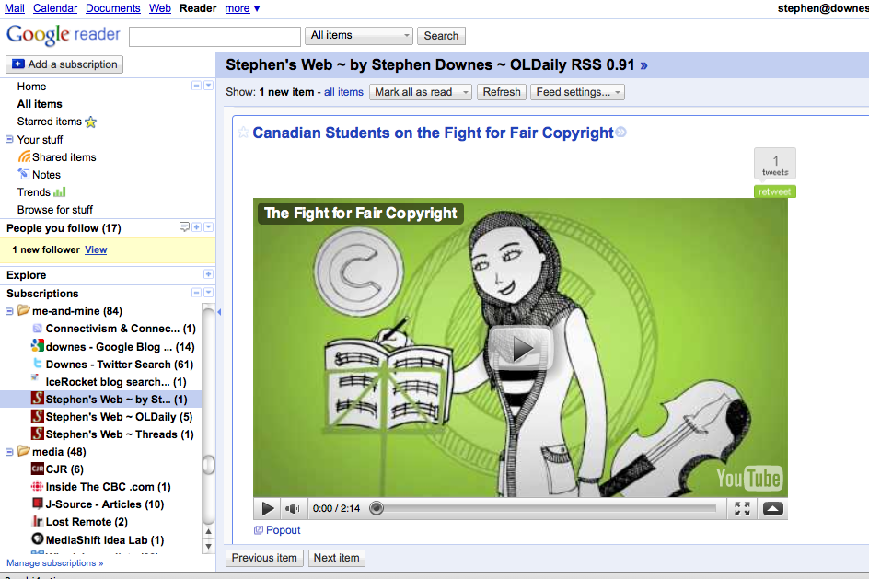
Aggregating
http://www.google.com/reader/

Slide 8
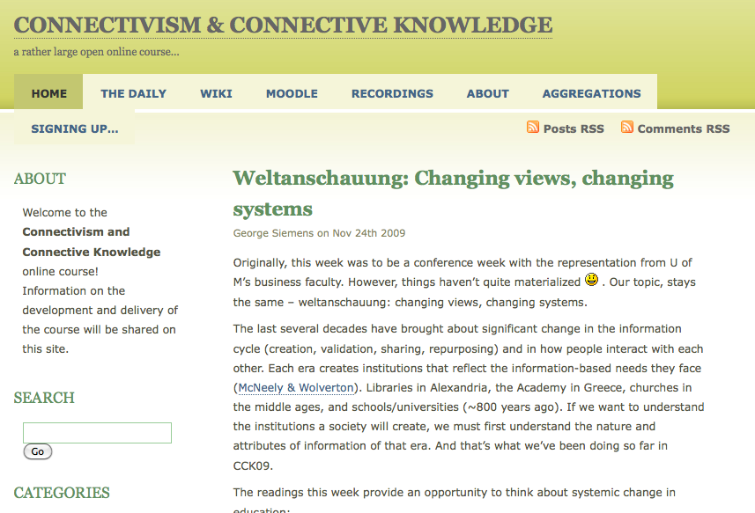
Connectivism Course
http://ltc.umanitoba.ca/connectivism/

Slide 9
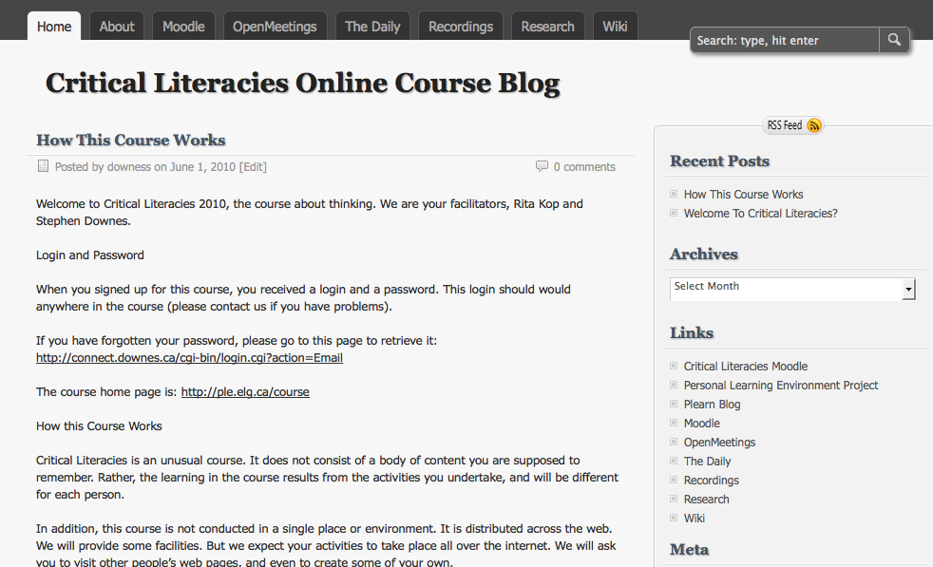
Critical Literacies
http://ple.elg.ca/course/?page_id=2

Slide 10
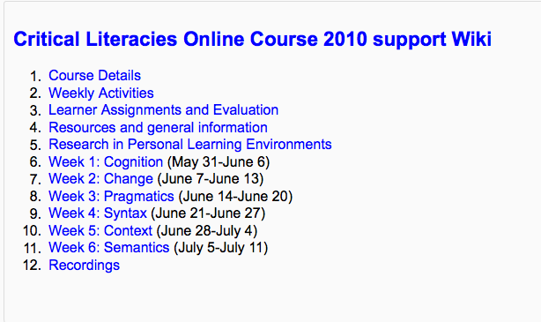
Course Structure
http://ple.elg.ca/course/moodle/mod/wiki/view.php?id=2

Slide 11
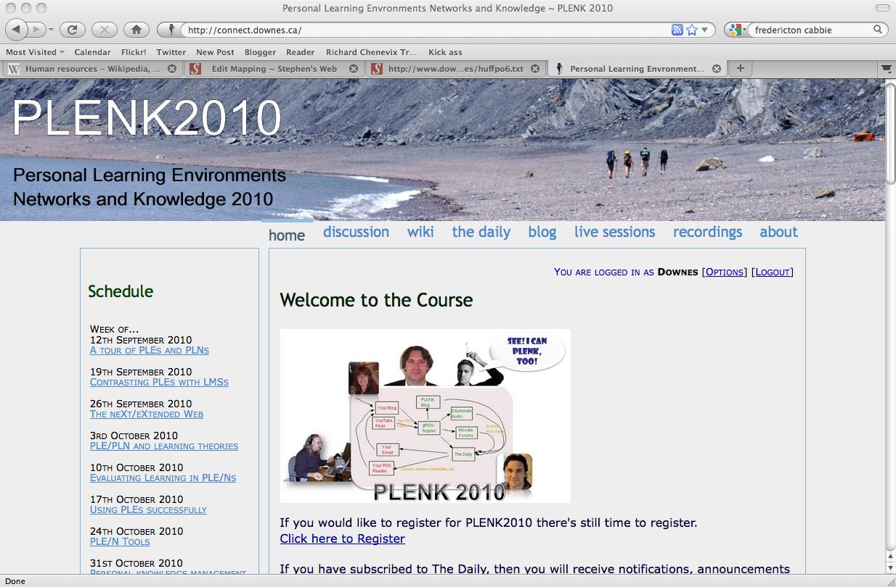
http://connect.downes.ca/

Slide 12
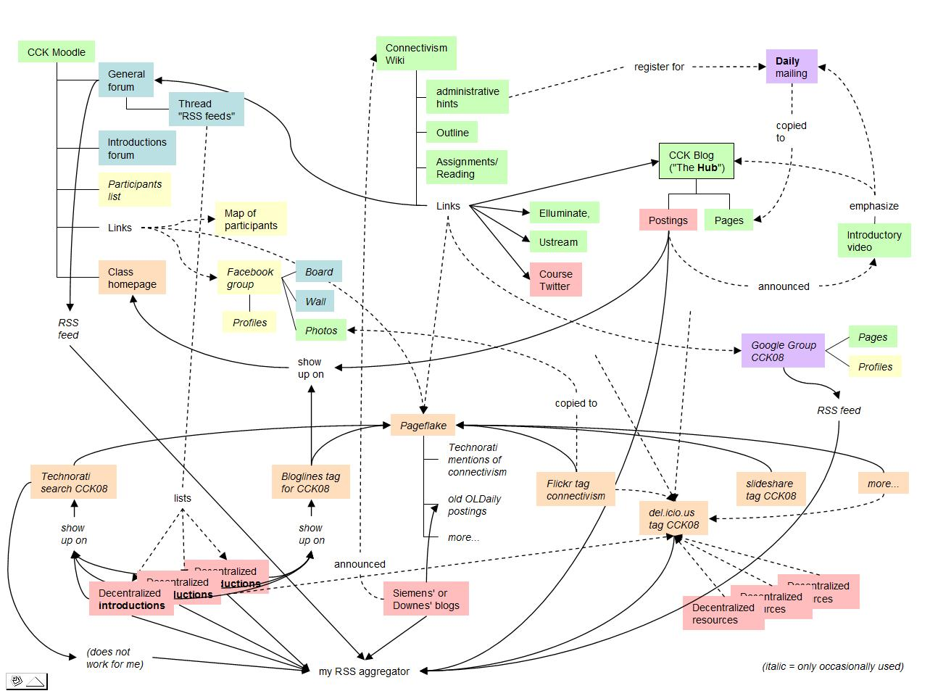
#PLENK2010
An instantiation of these constraints
A distributed learning environment
The MOOC
http://connect.downes.ca/

Slide 13
gRSShopper
A tool for learning networks
It functions as a node
Not as part of a mass
http://connect.downes.ca/cgi-bin/admin.cgi
http://grsshopper.downes.ca/

Slide 14
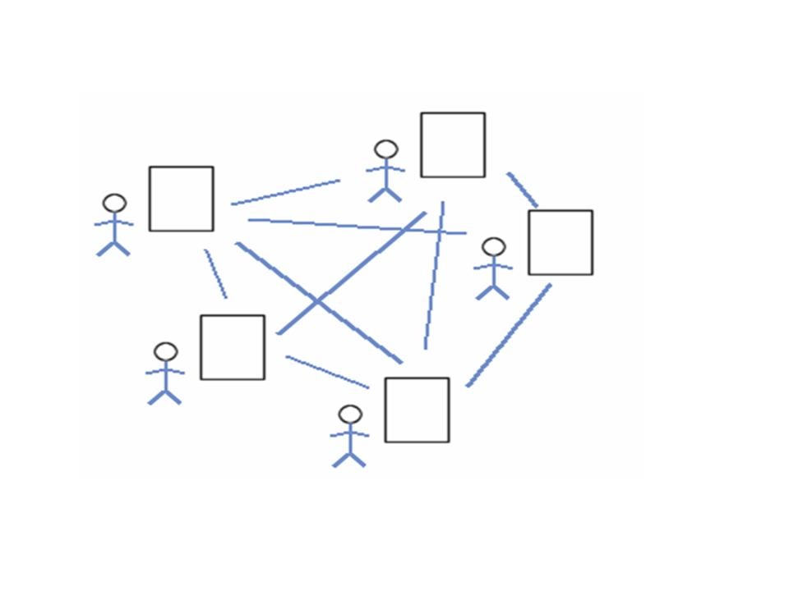
Collective Connective Intelligence
We are still in a world of mass, of masses of people, votes, ideas
These are the properties of the individual, applied to the whole
But the knowledge of a whole doesn’t lie in the parts – it lies in how these parts are organized.
http://www.downes.ca/post/43456

Slide 15
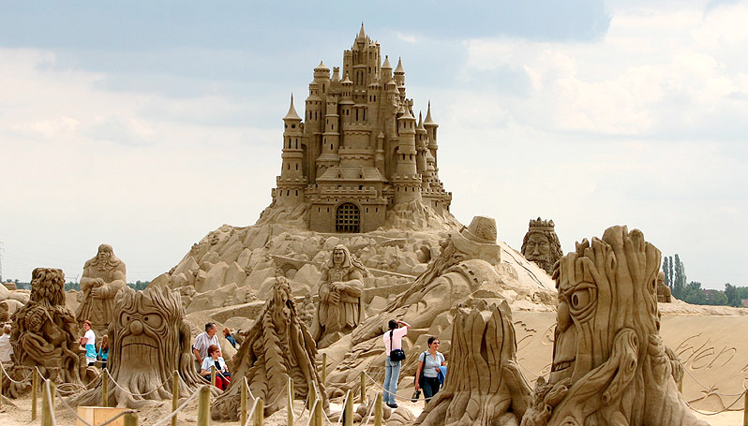
Organization
We’re trying to understand society by collecting individuals
But a sand castle isn’t just a pile of sand
Image: http://pixdaus.com/single.php?id=25529
http://www.downes.ca/presentation/257

Slide 16
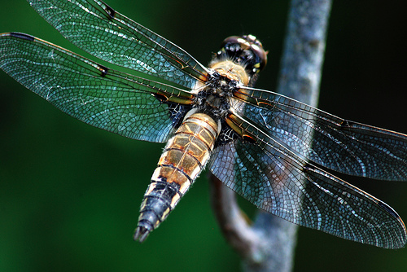
Connectivism
Knowledge is distributed across a network of connections
Learning is the ability to traverse and grow those networks
http://www.downes.ca/post/38653

Slide 17
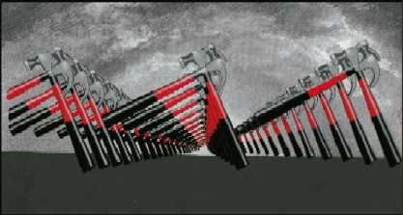
A connectivist course does not consist of a single identifiable group of people stepping through the same activity.

Slide 18
Engagement and Empowerment
There is no curriculum, no body of knowledge - McGuffin
The product of learning is the learner
Fernando Flores
Emotional Fortitude
21st century skills
Image: http://www.masternewmedia.org/news/2008/06/01/making_sense_of_new_technologies.htm
http://www.downes.ca/post/51122

Slide 19
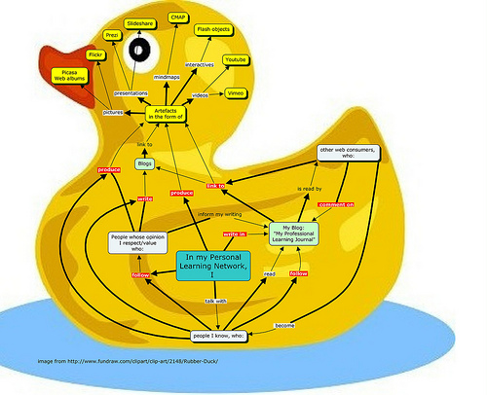
Connectivist Duckworks
Views from participants in PLENK2010
Image: http://www.flickr.com/photos/34318133@N03/5110104036/#/
http://enperfektlektion.blogspot.com/2010/10/would-i-pay-for-mooc-like-plenk2010_23.html

Slide 20
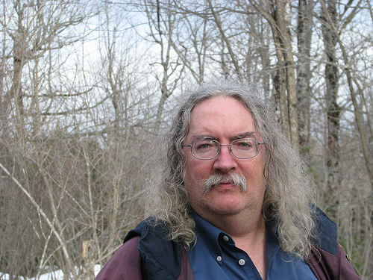
Stephen Downes
http://www.downes.ca
Author

Slide 21
http://www.downes.ca

